Slide 1
Data Insights for ANZ Management
Isaac Kar Wai Low (Data Analyst) – Data@ ANZ Program

Slide 2
Customer journeys AND BUILDING DIGITAL TRUST
In a world where skeptics and pioneers want more digital control of their financial data, collaboration and trust has to occur at all levels. No longer are reactionary tactics to regulatory compliance a trust-building mechanism in an open API economy. Developers, managers and third parties need to collaborate with their customers to develop in-house apps that suit their financial needs.
Instead of keeping our knowledge about our customer a secret, the insights gained from the customer journey maps here give cues to get your customer to build open up to you on how to manage their data.
With geolocation and time-based data at our fingertips, these are not hinderances to privacy. Instead they provide opportunities for open and learned discussion with your esteemed customers, whether it is about cybersecurity concerns, money management or digital convenience.

Slide 3
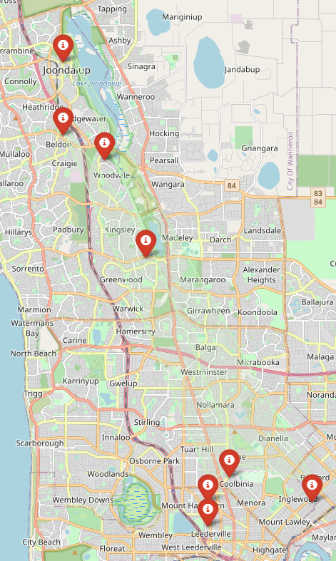
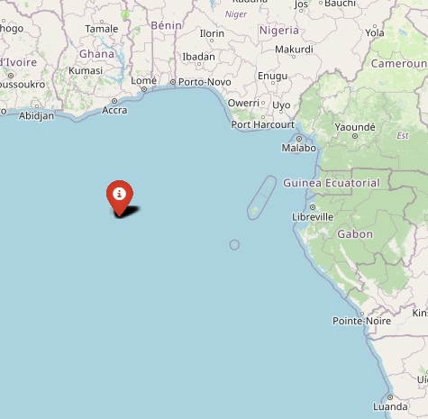
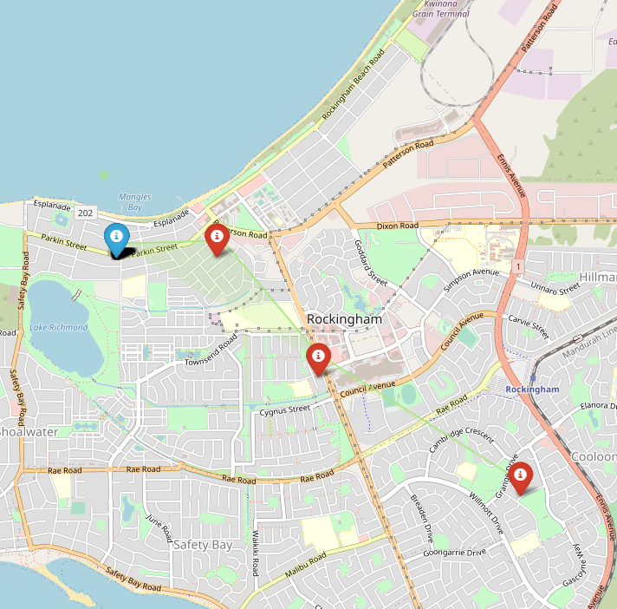
A Day in The life of Ruth
She’s a busy professional in Perth’s lively city
From the data we have gathered we can infer an hypothesis to test.
Ruth is a busy professional who enjoys her private life. She enjoys being able to travel to and from work and conduct her transactions globally without hassle. Occasionally, she is worried about her privacy and requires to make cash transactions in between lunch breaks and meetings.
Ruth number one concern is about her data privacy, and demands that ANZ staff disclose information that they have gathered from her.
With friendly and understanding approach, Ruth can be helped in more than just her transactions
Offshore salary in Sao Tome and Principe
Home base: A relaxing area near the beach

Slide 4

TOWARDS THE OPEN API ECONOMY
Building trust with third parties, developers and customers is quintessential in giving privacy and control back to the customers. Evidence has shown that traditionalists have low trust of banks due to lack of tech savvy
A collective effort to change the culture is essential to enable top management buy in to any infrastructure redesign project
With open APIs on the rise, developers and business analysts can work alongside your key customers to deliver custom made applications that can enable your customer more control of his or her financial activity.
The journey map above may be scary to the customer. But this is a chance for customer service representatives to flip the script. The new digital economy is about giving power back to the customer, so that they are the ones that sell your products

Slide 5
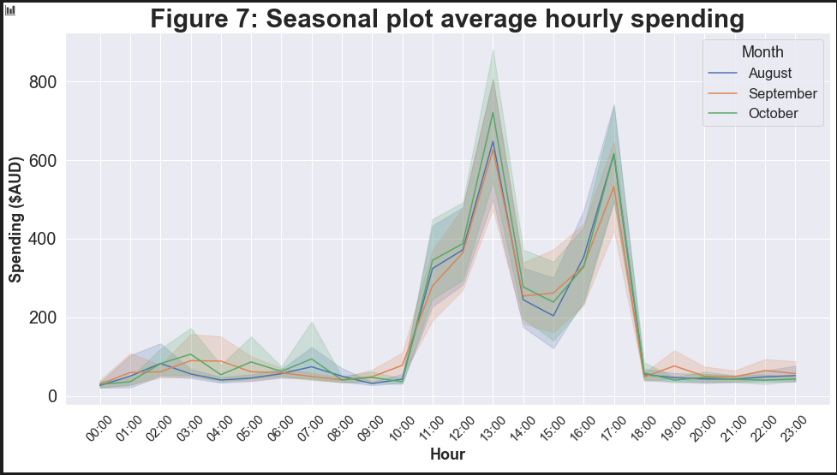
Time series insights
This seasonal plot is useful for the data analysts. But what if your customer is the one using this in a dashboard?
Enter Business as a Platform (BAAP). This new architecture will allow your customer to select relevant services that relate to his/ her own preferences
Potentially, the customer can track monthly spending and feel in control of his or her finances. Concerns of any matters of resolution are settled in one platform

Slide 6
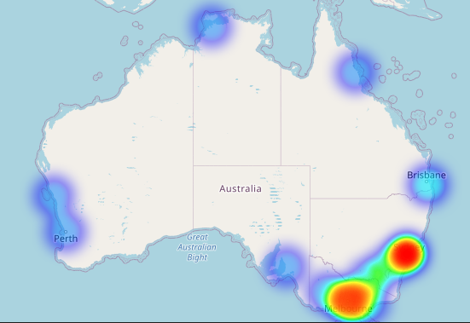
Transaction HeatMAP
This map demonstrates the current climate of banking
This means that banking is still largely centered along making location-based transactions
For the new digital economy and incorporating BAAP, this map should look more saturated in the coming years.

Slide 7
CONCLUSION
The new digital economy will be based on giving the power of data to the customer. The vision for developing an open banking system with transparent data is the new disruption model that banks should embrace.
Retail banking revenue streams are declining, and evidence shows that building trust is key to managing technological disruption from fintech and bigtech companies.
Building collaboration with developers and third-party API providers, educating customers, and most of all, applying the pioneer’s mindset will all contribute to this ideal goal.

Slide 8
Sources
https://www.mckinsey.com/industries/financial-services/our-insights/managing-a-customer-experience-transformation-in-banking#
https://www.mckinsey.com/business-functions/marketing-and-sales/our-insights/from-touchpoints-to-journeys-seeing-the-world-as-customers-do
https://www.accenture.com/us-en/insights/banking/consumer-study-making-digital-banking-more-human

